Slide 1


R.R. Institute Of Modern Technology
NH-24, Bakshi ka Talab,
Sitapur road, Lucknow-226201
MINI PROJECT
Submitted By:-
Gaurav Gupta
Ashish Verma
Neeraj Pandey
Himanshu Tiwari
( QUIZ WEBSITE)
Submitted To:-
Mr. Sahab Ahamad Siddiqui(Asst. Professor)
( Dept of CSD )
Department of Computer Science & Design

Slide 2
Project name: TRAINEEMOCK QUIZ WEBSITE
Introduction
Objective
Advantages
Tools
Conclusion
References
Future scope

Slide 3

Introduction
This project deals with use of web technology in the field of e-learning. Nowadays e-learning platform are encouraged as lot of manual work is not done and also it helps in saving time. People anywhere in the world with an internet connection can easily use these platforms.
Online examination is efficiently used in day to day life because it saves time and also it is most accurate system as maximum participants are increasing in today’s life. Online examinations are available with instruction and guidelines so that students can understand properly. It is necessary for every technical student to have basic knowledge of online examination system. All the entrance exams are held online because of its fast and accurate marking scheme. Online examination is more flexible than written examination. It is basically design to promote the variation in education system. Due to online examination there is less chance of losing integrity of exam pattern. For e.g. it is least possible for disposing the online examination setup when compared with other examination system.

Slide 4
Objective
The main objective of this Online Quiz Application is to provide an online platform for both teachers and students so that teacher can take various tests or assignments in the form of quiz and students after going through a concept can assess him/herself by the quiz questions being uploaded by teacher thus also reducing the manual paper work.
Saves time.
Reduce workload.
Promote e-learning.

Slide 5



Tools

Slide 6
HTML
HTML (Hypertext Markup Language) is a text-based approach to describing how content contained within an HTML file is structured. This markup tells a web browser how to display text, images and other forms of multimedia on a webpage.

Slide 7
CSS
Cascading Style Sheets, fondly referred to as CSS, is a simple design language intended to transform the presentation of a Web Pages as well as many ostensibly non web environments.
CSS handles the look and feel part of a web page. Using CSS, you can control the color of the text, the style of fonts, the spacing between paragraphs, how columns are sized and laid out, what background images or colors are used, layout design ,variation in display for different devices and screen sizes as well as a variety of other effects.

Slide 8
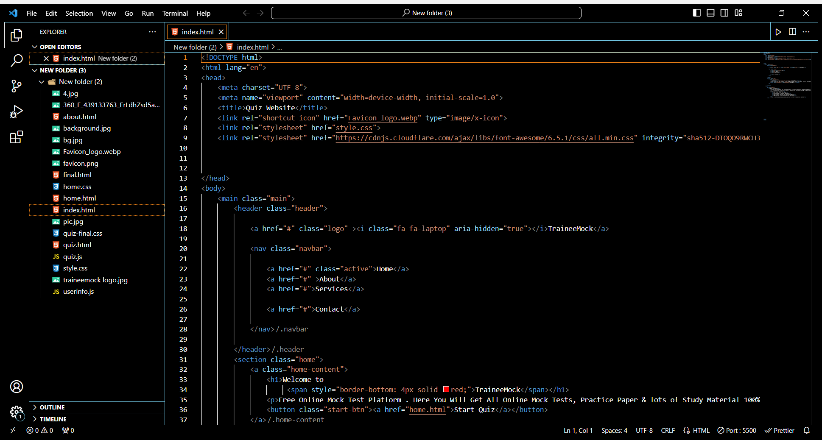
Setting the homepage structure

Slide 9
Benefits
Easy & flexible creation and customization. ...
Individual design. ...
Use of different question types & media. ...
Reach many participants. ...
Involve target group. ...
Give user defined feedback. ...
Automatic evaluation and display of results. ...
Mobile-capable.

Slide 10
Future scope
Constant technological development leads to a rapid expansion of the assessment industry. Many of the coaching institutes and learning centers are developing their interest in conducting online tests through the online examination software for their students instead of pen and paper-based exam. It clearly proves that the online examination software is the future of assessment methodology.
Online Examination System is widely used as system can be used in private institutes as well as educational in compared to other exams .Online examination situation. As it is user friendly web base application it can be used anywhere and anytime.
Every software may have some cases of bugs, errors, security related problems or system faults. There are many problems or system faults for example; computer collapse or crashes due to power supply produce wrong results or may display invalid data. These bugs must be identified and solved for improving quality of software. So problem will invalidate efforts of number of students. There are large numbers of chances in which software in future we can develop more secure software by using advanced technologies.

Slide 11
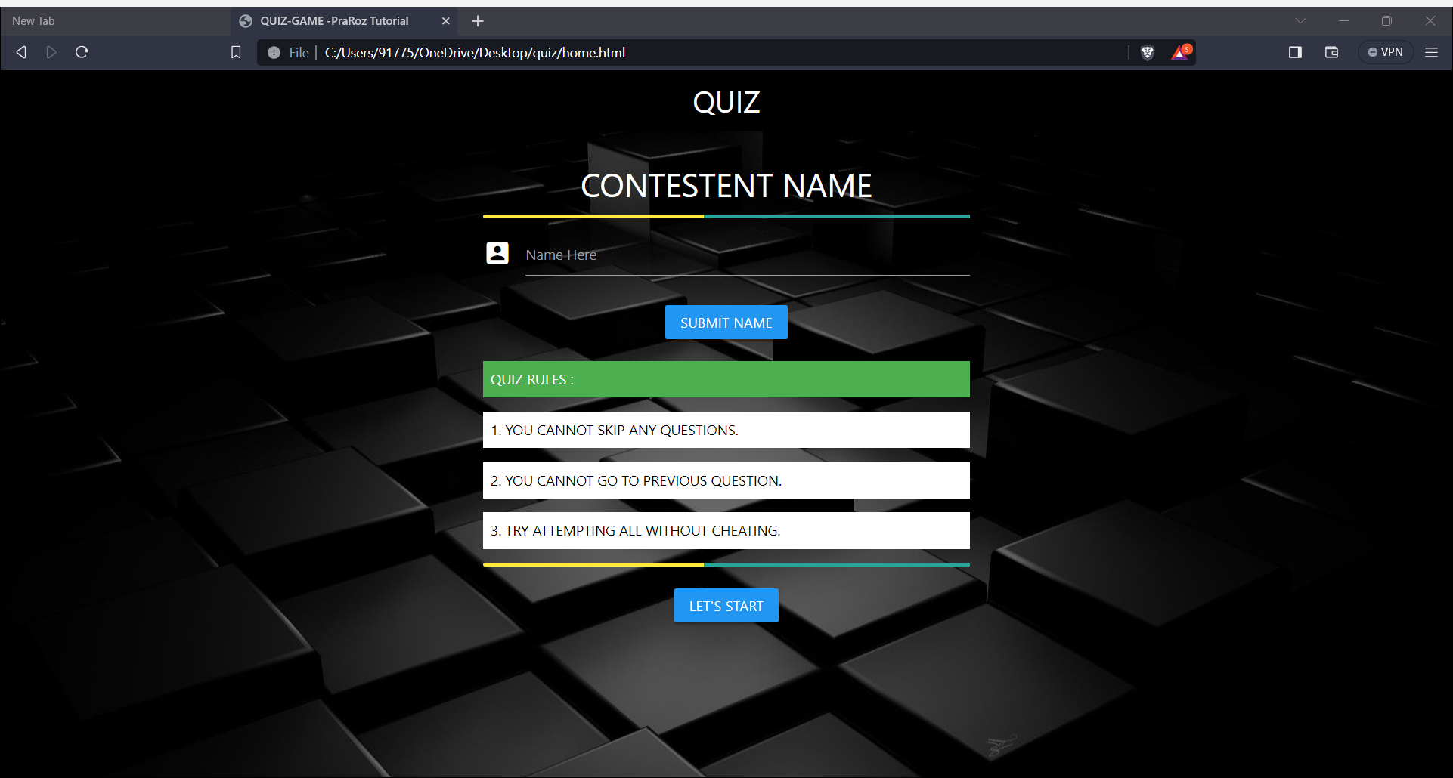
Project : Snapshot

Slide 12
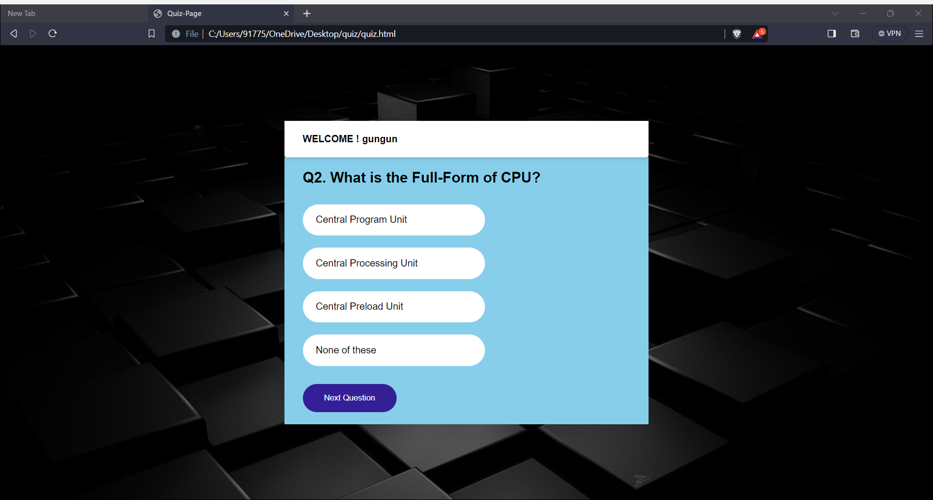

Slide 13


Slide 14
Reference
You tube
W3school / CSS

Slide 15
CONCLUSION
Online Examination System is significantly superior among the other exams. We have come to result that the problems can be solved by introducing new security systems using biometrics, we can identify the student’s true identity by analyzing digital signature or by finger print mechanism and also by providing web cameras in the examination hall. Although web cameras Sometimes gets failed, if supposed a candidate is giving exam and facing downwards in such case Iris recognition and face recognition must be used. We conclude that no mechanism is ideal. Each mechanism has some restriction on its own. Key concepts are to develop paperless environment and to convert all the documentation in digital form.

Slide 16


